Slide 1
Smartphones and Global Connectedness
Name
Professor
Institution

Slide 2
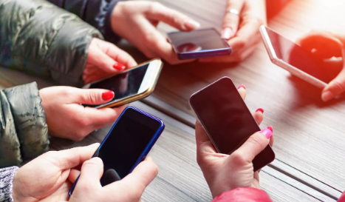
Introduction
Smartphone are connecting the world today
Facebook and Twitter have become more popular
The surfacing of new technology has created a new platform for business
The young people are using Smartphone to socialize
Notes:
The young people are the target group in this plan. Study has shown that the teens between 16 and 24 years of age are the ones who use the internet and Smartphone the most. In reality, the young people are using Smartphones in large numbers, and this has created an opportunity for business and online marketing (Phillips, 2014). The rise of social networks such as YouTube and Twitter have helped the world to be interconnected. With the new technology, the internet has helped the world to be connected (Salehan and Negahban, 2013). The use of Smartphone has been a major boost to world connectivity because these gadgets have improved communication and business. Today, it is possible to do business from the comfort of our homes thanks to Smartphones

Slide 3
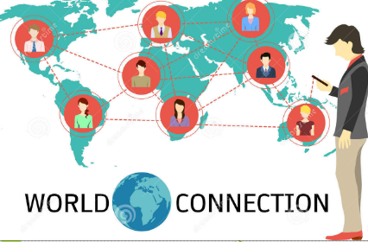
Goals of this plan
The objectives is to;
To understand how Smartphone connect the world
The aim is to understand how the target group use the Smartphone today
To understand how the cell phone will connect the world in the future
To understand how Smartphones have greatly influenced how people interact and form relationships
Notes:
Smartphone are connecting the world today. With the advent of new technology, the Facebook and Twitter have become more popular. The surfacing of new technology has created a new platform for business, social media, and education (Phillips, 2014). The young people are relying on the Smartphone to communicate and keep in touch with the world. The goal of this project is to help us understand how the Smartphone is connecting the world today. Study has shown that young people use the internet very much and that is why they are the target group for this project. The young people are said to spend more than seven hours on the internet daily. With the growth of technology, it means the Smartphone will continue to connect the world in better ways in the future. Companies should embrace this idea and capitalize on it because will help in marketing and brand awareness, especially to young people (Salehan and Negahban, 2013).

Slide 4
Recommendations
Advice young people
Provide education programs to young people
Regulate the social media
Encourage positive attitude on the internet
Encourage constructive communication for positive global connectivity.
Negotiate with the teens about the appropriate time to spend using the Smartphone
Notes:
Young people should be advised on how and when to use the Smartphone to reduce harmful effects, especially because study has shown that the use of internet among the teens has been linked to high addiction (Salehan and Negahban, 2013). There is a need for an education program to teach and inform our children about the use of internet today. Teachers and parents should be care providers because our kids will become addicts of the internet (Phillips, 2014). With appropriate education, teens will use Smartphone appropriately for socialization, learning, and business. Teachers and parents should encourage students to use the Smartphone to engage in constructive communication for positive global connectivity. It is important to negotiate with the teens about the appropriate time to spend using the Smartphone. This is a good idea because a majority of them will waste time because either they spend too much time on the internet or they engage in harmful activities using their cell phones.

Slide 5

Challenges
Resistance from young people
Addiction issues
Privacy concerns
Security issues
Bullying issues on the internet
Notes:
The world has become more connected with the growth of the internet and new technology. Now more than ever, children have become socially active and it has become easier to address social issues. Teachers and parents can now easily connect with the world thanks to internet. The teens are using Smartphones to connect with their peers and relatives more frequent. This plan will provide us an opportunity to understand how we can improve the social networks to provide children with better opportunities for social engagement. However, there are some challenges that arise with this plan. The plan will face resistance from teenagers. The addiction issue is another thing we may face especially from young people who now over depend on using the internet. Security and privacy concern is synonymous with the use of internet. Teens should be aware of this issues so that they can gain positively on the internet. The internet also creates a platform for teens to bully others. Teachers and parents should encourage teens to have positive behaviors to avoid such issues for positive social change.

Slide 6
Strengths of this plan
Will gather data about the benefits of Smartphone and connectedness
Will provide actual information from the ground
Will help us understand how the young people use internet for global connectivity
Will help understand the effects of teens using the Smartphone
Provide a platform for teens to learn about using the Smartphone positively
Notes:
The plan will create an opportunity to understand how internet is changing the world today. This will help to gather data about the benefits of Smartphone and connectedness in the society today. The project will also help to collect actual data from teens on the ground when seeking to understand how these young people use the internet for global connectivity (Phillips, 2014). In addition, this plan will provide an opportunity to understand the effects of teens using the Smartphone. Research has shown that the continuous use of internet among young people has negative effects because sometimes the young people will watch pornographic films, learn about drugs, and waste time. There is a need for education program to help the young people to overcome this challenges. This project will provide a an excellent platform for teens to learn about using the Smartphone positively to communicate and connect with the world. The future will be bright if the teens learn such positive values today.

Slide 7
References
Phillips, C. (2014). How Smartphone revolutionized society in less than a decade. Government Technology.
Salehan, M., & Negahban, A. (2013). Social networking on smartphones: When mobile phones become addictive. Computers in Human Behavior, 29(6), 2632-2639.

